Slide 1

E-PHARMACY
G.SRIKANTH 1602-16-737-320
K.HRUDAYANAND 1602-16-737-321

Slide 2
Abstract
This web site is designed to “chat/call ” with doctor to take adviced related to the diseases and the medical measure will be displayed
The photo copys are attached for better understanding for doctors .The files can be shared and we use multiple times.
The doctor can suggest best remedies for health issues with the best medicine
Paper work will be reduced.and time saving will much better Than waiting in line and all the medicines are at place will instructed.

Slide 3
Existing System
User select the Medicine
Not every disease required medicine
No precaution steps
No description about disease

Slide 4
Proposed System
Provide description about disease
Provides precautions steps
Suggest whether the medicine are required or not

Slide 5
Modules
->ADMIN ->USER
1. Administrator Module Admin can Upload details about Disease and View medicines. Admin can view purchased medicines. 2. User Module User can login and Enter the Disease. User can get description about the disease. If medicine requires he/she can order it online. User can give feedback about pharmacy

Slide 6
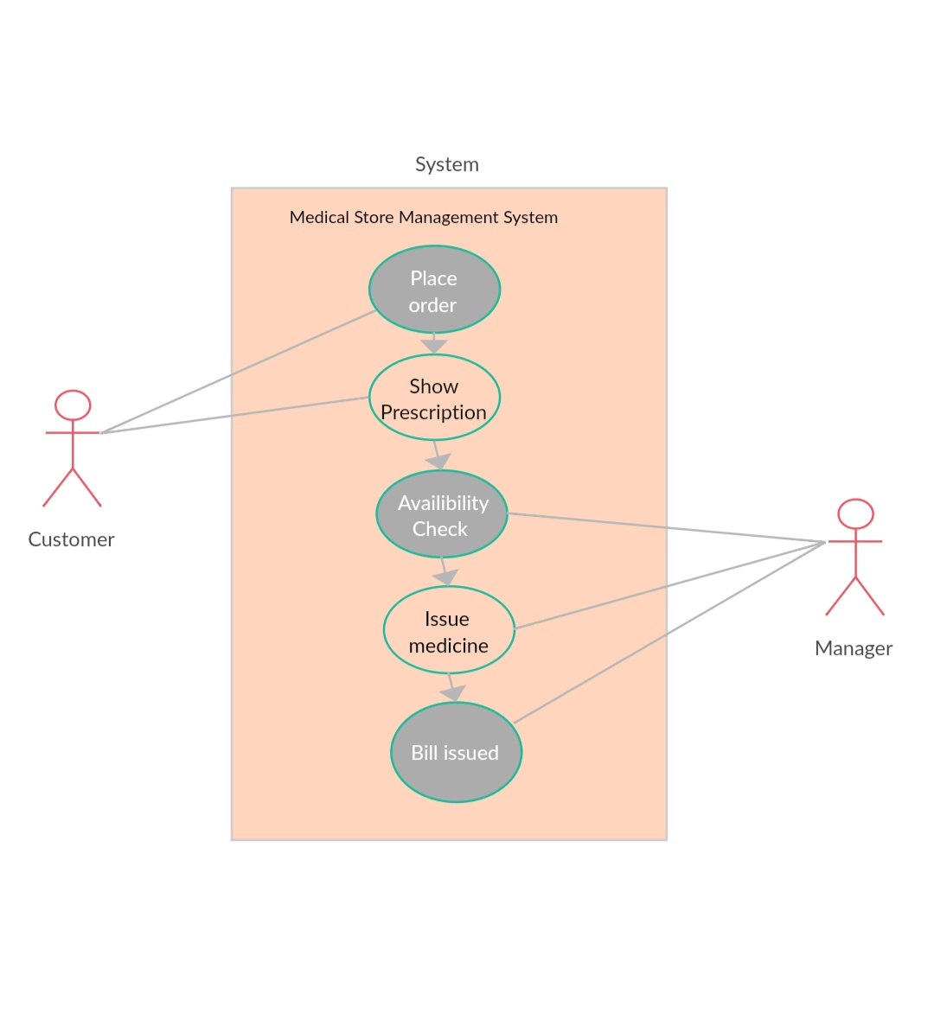
Use case daigram

Slide 7
Software Requirements
Operating System : Windows Technologies : ASP.NET Html, JavaScript, CSS Database : My SQL

Slide 8
Conclusion
The internet has become a major resource in modern business, thus medicine shopping has gained significance not only from the entrepreneurs but also from the customers point of view. For the entrepreneur, medicine shopping generates new business opportunities and for the customer, it makes customer to get best medicine and cured fastly.

Slide 9


